Slide 1

MAULANA AZAD NATIONAL INSTITUTE OF TECHNOLOGY , BHOPAL (M.P.)
DEPARTMENT :COMPUTER SCIENCE AND ENG.
TEAM
RITESH MEENA SCH.NO 171112229
RITIK BANSAL SCH.NO 171112237
RAHUL SINGH SCH.NO 171112216
CHARAN SINGH FAGNA SCH.NO 171112295
MINOR PRESENTATION
BATCH OF 2021 ,BTECH, 6TH SEM
MENTOR : PROF. MANSI GYANCHANDANI

Slide 2
DIFFERENTIAL PRIVATE MODEL – A NOVEL APPROACH
Using Deep learning, python

Slide 3
Contents :
Introduction
Problem definition
Proposed Work/Available Solutions
4. Methodology
5. Results
6. Conclusion
7. References

Slide 4
Introduction __
Hi there !
lets start , our project is ,as we say , “Differential Private Model – A Novel Approach”
For many critical applications ranging from health care to social sciences, releasing personal data while protecting individual privacy is paramount. Over the years, data anonymization and synthetic data generation techniques have been proposed to address this challenge.
Unfortunately, data anonymization approaches do not provide rigorous privacy guarantees.
Although, there are existing synthetic data generation techniques that use rigorous definitions of differential privacy, to our knowledge, these techniques have not been compared extensively using different utility metrics.
So we pushed the theoretical commitments of researches and Prepared a model which is capable
Of providing Data Privacy while holding the integrity of its original form.

Slide 5
Problem Definition __
AIM :
We propose an auto-encoder Model, a generative deep learning technique that generates privacy preserving synthetic data. We test our approach on MNIST dataset and compare the results for data without Noise and data after applying DP Noise in the weights.

Slide 6
Proposed Work / Available solutions__ :
Increasingly more data is collected about almost every aspect of human life ranging from health care delivery to social media. As the amount of collected data increases, more opportunities have emerged for leveraging this collected data for important Societal purposes which results into the privacy issues for an individual user.
To address this privacy challenge, solutions have been proposed in two broad categories.
Data anonymization based approaches :
which try to use various definitions to sanitize data so that it cannot be easily residentified. Although these approaches have some important use cases, they are not usually based on rigorous privacy definitions that can withstand various types of re-identification attacks.
2) Synthetic data generation approaches :
have been proposed to generate realistic synthetic data using rigorous differential privacy definition that we tried to implement and improve in our project..

Slide 7
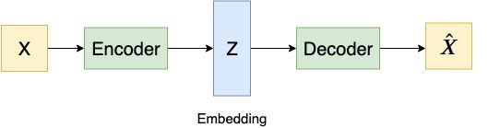
Conceptual Knowledge
7.1
Traditional Auto-Encoder
The traditional autoencoder is a neural network that contains an encoder and a decoder. The encoder takes a data point X as input and converts it to a lower-dimensional representation (embedding) Z. The decoder takes the lower-dimensional representation Z and returns a reconstruction of the original input X-hat that looks like the input X. The quality of the embedding determines the quality of the output X-hat.
However, it might not be possible for the encoder to encode all information because the embedding has a lower dimensionality than the input. Therefore, if the embedding captures more information from the input, the output will have a better performance.

Slide 8
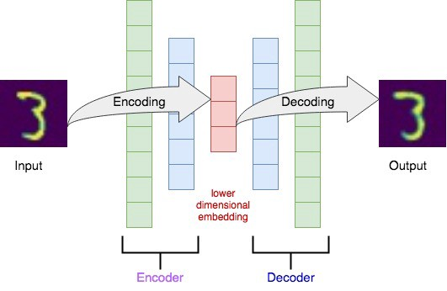
7.1
The architecture of
Encoder and Decoder
The MNIST dataset contains grayscale images and each image has a shape of 28 by 28 pixels. The encoder takes this image and converts it to a lower-dimensional embedding Z. The decoder takes the embedding Z and returns a reconstructed input image, which is the output of the autoencoder.

Slide 9
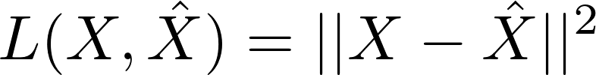
7.1
Loss Function For Basic Autoencoder
The loss function of an autoencoder measures the information lost during the reconstruction. We want to minimize the reconstruction loss to make X-hat closer to X. We often use mean square error as our loss function, which measures how close X-hat is to X.
Mathematical
equation

Slide 10
Variational Autoencoders
7.2
One of the biggest advantages of the variational autoencoder is that VAE could generate new data from the original source dataset. In contrast, traditional autoencoder could only generate images that are similar to the original inputs. Let’s say you want to build a garden that is filled with bushes. Every single bush needs to be different so your garden would look real. You definitely can’t draw every single bush by yourself, a smarter way is using variational autoencoder to automatically generate new bushes for your garden.
Why do we need variational autoencoders?

Slide 11
Architecture of VAE

Slide 12
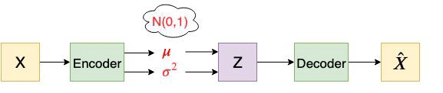
Concept Of VAE
The main idea of a variational autoencoder is that it embeds the input X to a distribution rather than a point. And then a random sample Z is taken from the distribution rather than generated from encoder directly.
The encoder takes a datapoint X as input and generates μ and logσ² as outputs. The reason that we use logσ² instead of σ² is that σ² is non-negative, so we will need an extra activation function. But logσ² could be positive or negative. After we get μ and logσ², we try to make both μ and logσ² close to 0, which means μ is close to 0 and σ is close to 1. Therefore the final distribution will be close to N(0,1). Finally, we want to generate the embedding Z from μ and σ by z = μ + σ * ε, where ε ~ N(0,1). This is called the reparameterization trick. Now with the latent variable Z, we can generate our output X-hat through the decoder.

Slide 13
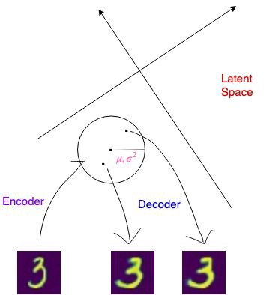
Architecture of Encoder and Decoder
The encoder for a VAE is often written as qφ(z|x), which takes a data point X and produces a distribution. The distribution is usually parameterized as a multivariate Gaussian.
Therefore, the encoder predicts the means and standard deviation of the Gaussian distribution.
The lower-dimensional embedding Z is sampled from this distribution. The decoder is a variational approximation, pθ(x|z), which takes an embedding Z and produces the output X-hat.

Slide 14
7.2
Loss Function For VAE
The loss function for VAE has two parts. The first part of the loss function is called the variational lower bound, which measures how well the network reconstructs the data. If the reconstructed data X is very different than the original data, then the reconstruction loss will be high. The second part of the loss function works as a regularizer. It is the KL-divergence of the approximate from the true posterior (p(z)), which measures how closely the output distribution (qφ(z|x)) match to p(z).
Mathematical
equation

Slide 15
Application of Autoencoders
2) Basic Autoencoders
1) Variational Auto Encoders
Image Colouring
Converts Black & white pictures into coloured Images
Feature Variation
Only Extracts the Useful Features
Denoising Images
Learns IMP features and ignores noises
Dimensionality Reduction
Provides same Image with Reduced Pixel Value
Deep Recurrent Attentive Writer (DRAW)
Recurrent Neural Net For Image Generation
Semi-supervised Learning
make use of both labelled and unlabelled data
Sentence prediction
Words are represented using a learned dictionary
of embedding words
VAE for Privacy
Performs Inference of latent variables by adding noise
Records are made safe for data mining
3) Deep Autoencoders
Data Compression
Deep autoencoders are used for semantic hashing
Image Search
Images are converted into a 30 number vector
Topic Modelling & Information Retrieval

Slide 16
Methodology
MNIST Classification
K Means Clustering is used on MNIST dataset
Variational Autoencoder
VAE Model is compiled and fitted on mnist and Weights are saved
Inserting Noise For Privacy
Gaussian Noise with 2 different std value is added

Slide 17
Step 1
MNIST CLASSIFICATION
K Means clustering Technique is used on MNIST dataset to differentiate it into cluster sets from 0 to 9
Assume that we have the sensitive dataset D = { (x1, y1) , ... ,(xm, ym) }, where every instance x has a label y. We partition the sensitive dataset D into k groups such that every instance x in a group has the same label y. The value of k is limited by the number of unique labels in dataset D.

Slide 18
CLASSIFICATION
RESULTS

Slide 19
Step 2
VARIATIONAL AUTOENCODER
A Artificial Neural Network is created with two Dense layer , one internal layer with Rectified Linear Unit(relu) activation function and reduced size and another output layer with sigmoid function.
Autoencoder Model is applied on it & compilation of model is done
The Autoencoder if fitted over the dataset
Finally the weights obtained from training the model are saved for future processing

Slide 20
The Auto-encoder employs steps to improve the optimization process with gradient computation and clipping. While a gradient is computed for a batch, we compute the gradient for each training instance instead. This approach improves the optimization process since it reduces the sensitivity of the gradient present at each instance.

Slide 21
Step 3
Gaussian Noise
We infuse gaussian noise with different epsilon value in the saved weights.
Then these updated weights are loaded into the autoencoder model and the results are compared with the original output.
8.5
Our main framework aims to generate synthetic data without sacrificing the utility. A similar approach is proposed which designs a private convolutional neural network on supervised learning. However, this method can only be used in classification tasks. We combine this method with DP and to create a generative deep learning model.

Slide 22
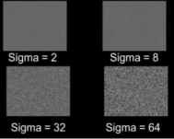
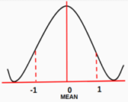
What Is Gaussian Noise??
3. Effect of Standard Deviation(sigma) on Gaussian noise:
1. Gaussian Noise is a statistical noise having a probability density function equal to normal distribution, also known as Gaussian Distribution. Random Gaussian function is added to Image function to generate this noise. It is also called as electronic noise because it arises in amplifiers or detectors. Source: thermal vibration of atoms and discrete nature of radiation of warm objects.
The magnitude of Gaussian Noise depends on the Standard Deviation(sigma). Noise Magnitude is directly proportional to the sigma value.
2. The side image is a bell shaped probability distribution function which have mean 0 and standard deviation(sigma) 1.

Slide 23
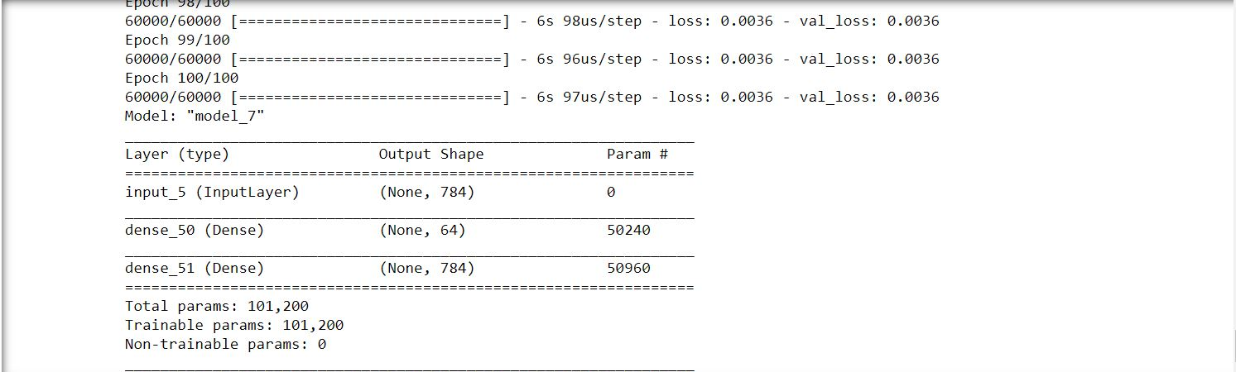
RESULTS :
1) We trained our Auto Encoder Model with 5 Input Dense Layers of DNN for 100 Epochs.

Slide 24
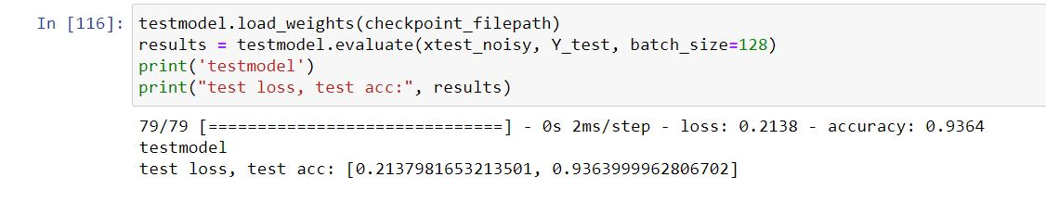
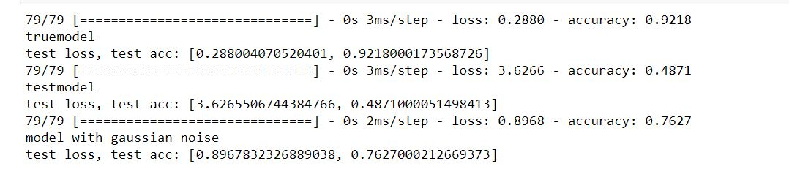
9.1
2) Accuracy of Model Without Noise Addition is => 93.6%
3) Accuracy of Model After DP Noise Addition is => 76.27%

Slide 25
9.2
Epsilon value | Sensitivity /Epsilon Value | Model Accuracy
Without Noise ( Original ) | -- | -- | 93.6%
After Gaussian Noise Addition Result 1 | 10 | 0.1 | 92.1%
After Gaussian Noise Addition Result 2 | 20 | 0.05 | 76.2%

Slide 26
CONCLUSION
We proposed a new generative deep learning method that produces synthetic data from a dataset while preserving the utility of the original dataset. Our generative auto-encoder method partitions the original data into groups, and then employs the private auto-encoder for each group. Auto-encoder learns the latent structure of each group, and uses expectation maximization algorithm to simulate them. This approach eliminates impurity of groups and results in more accurate.
Also we save the excessively large computation time required by modifying the weights, which eliminates the trouble of fitting the data into the model for every twerk made.

Slide 27
References __
1. Abadi, M., Chu, A., Goodfellow, I., McMahan, H.B., Mironov, I., Talwar, K., Zhang, L.: Deep learning with di_erential privacy. In: Proceedings of the 2016 ACM SIGSAC Conference on Computer and Communications Security. pp. 308{318. ACM (2016)Steeve Huang. Introduction to recommender system. part 1 (collaborative filtering, singular value decomposition).
2. Machine Learning and Differential Privacy Maria-Florina Balcan.
3. Privacy Preserving Synthetic Data Release Using Deep Learning ( Nazmiye Ceren Abay, Yan Zhou, Murat Kantarcioglu, Bhavani Thuraisingham, and Latanya Sweeney )
4. Deep Learning with Differential Privacy ( Martín AbadI, Andy Chu, Ian Goodfellow, H. Brendan McMahan, Kunal Talwar )
5. Link- https://towardsdatascience.com/tutorial-on-variational-graph-auto-encoders-da9333281129
6. Link - https://medium.com/image-vision/noise-in-digital-image-processing-55357c9fab71

Slide 28
Thanking you for giving your precious time….
Special thanks to our mentor Dr. Mansi Gyanchandani Mam
for her support through the entire project.
TEAM
RITESH MEENA SCH.NO 171112229
RITIK BANSAL SCH.NO 171112237
RAHUL SINGH SCH.NO 171112216
CHARAN SINGH FAGNA SCH.NO 171112214

